Slide 1

What’s For Dinner Tonight?
RecipeLive: A Recipe Recommendation Application Using Images of Produce
Hemanth Devarapati

Slide 2
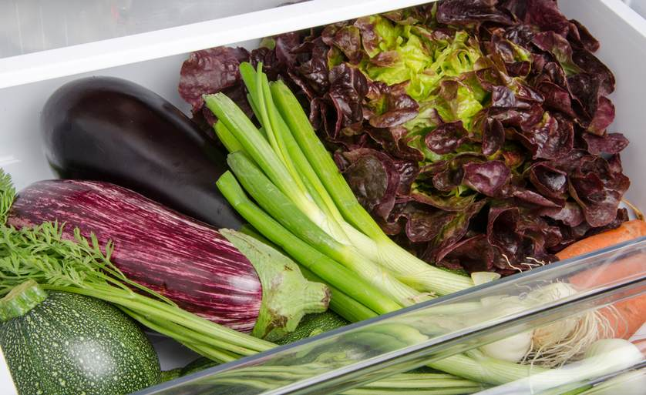
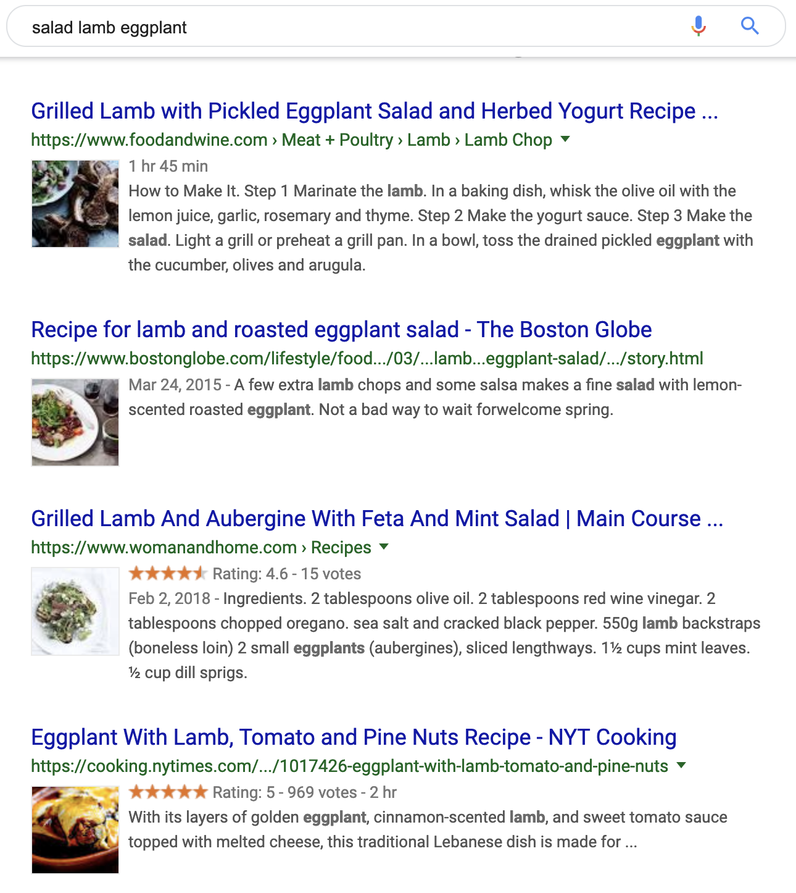
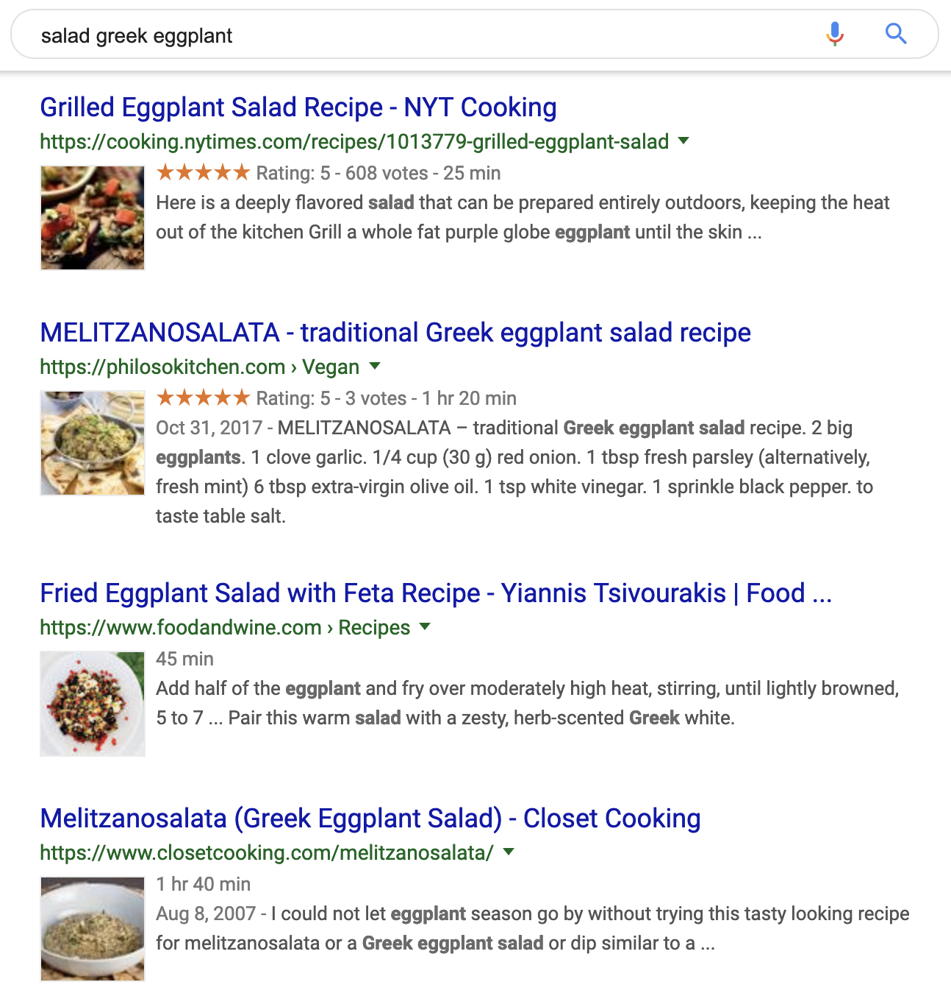

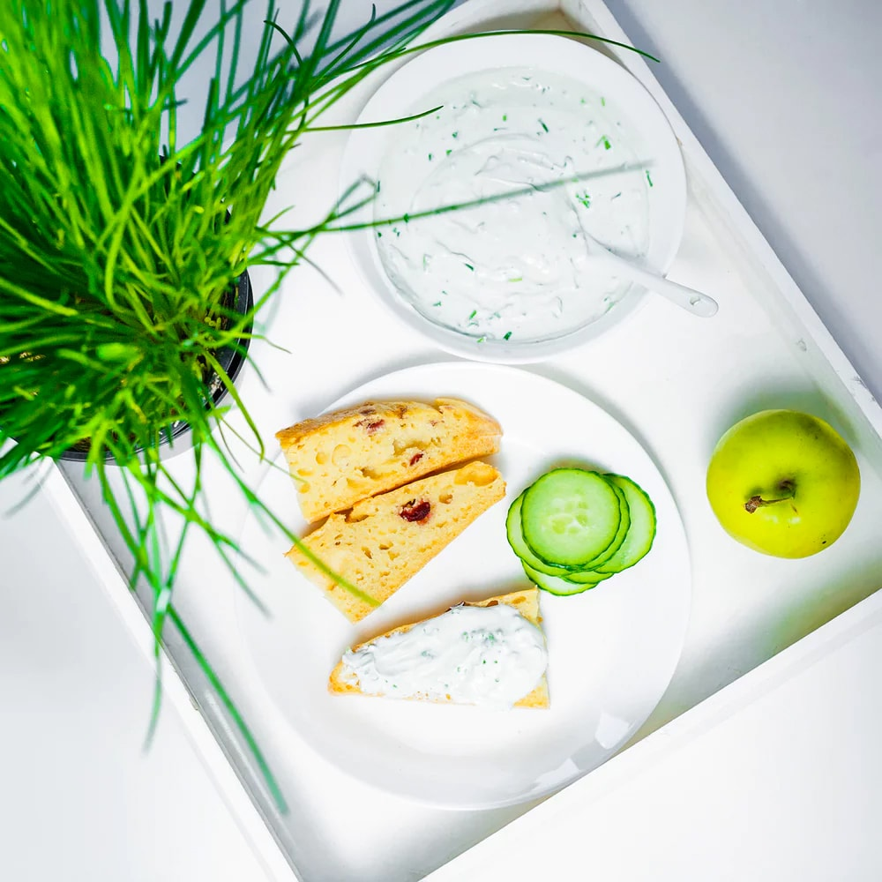
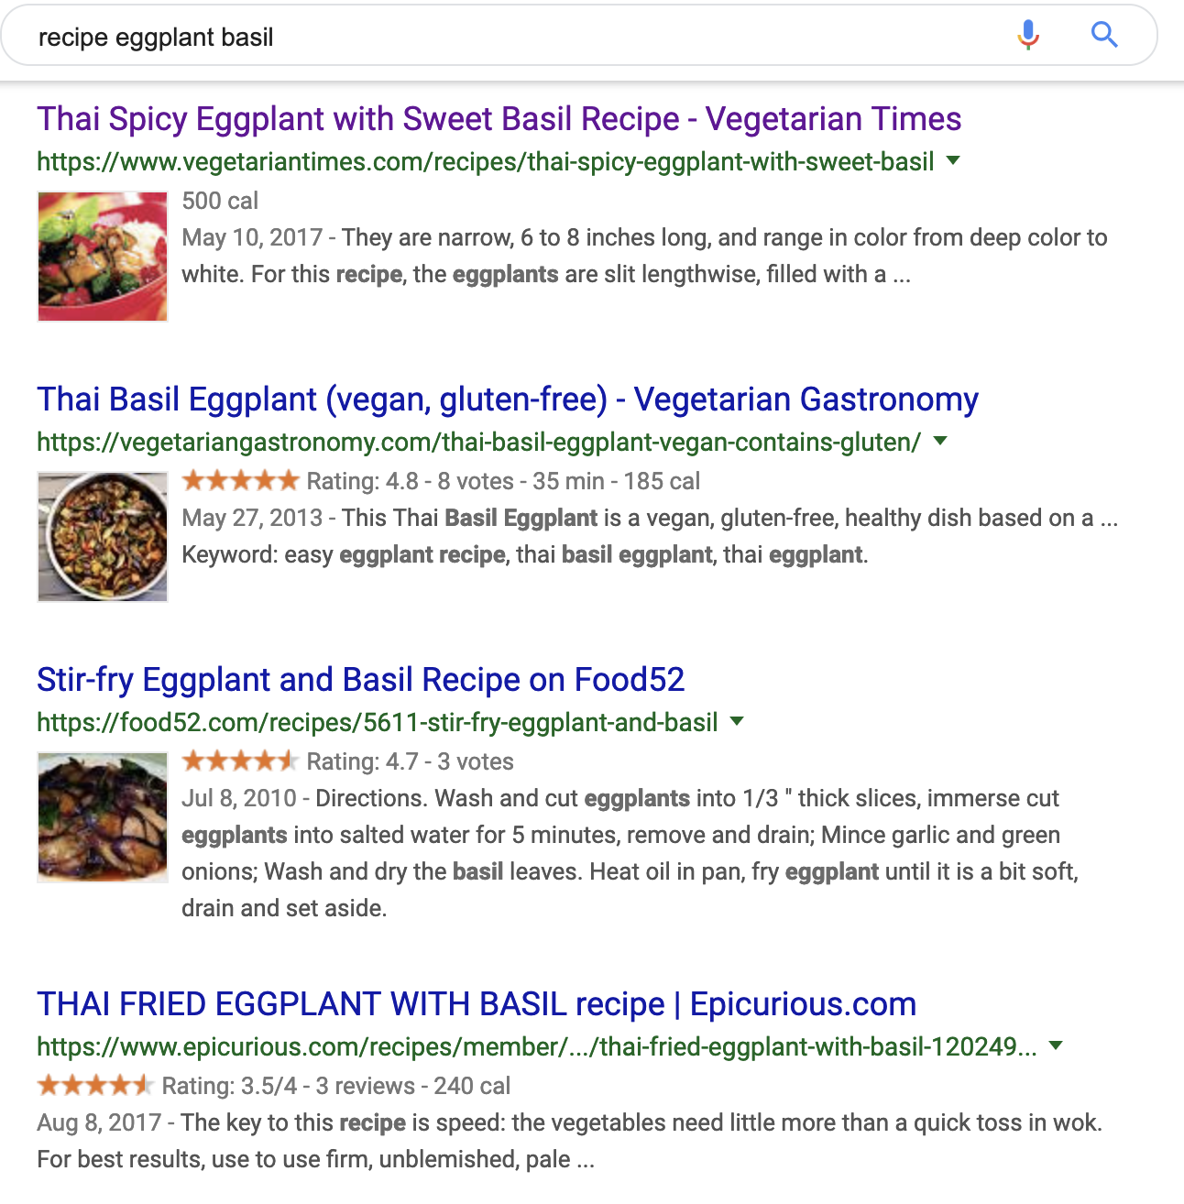
Inconveniences in Recipe-Searching
Countless Search Results
Eggplant
Tomato
Basil
Leftover Produce
Typical Procedure
Visit each website
Repetitive check for
Ingredients?
Prep. Time? Method?
Nutrients? etc.
3. Select a recipe!
(~30-min later)

Slide 3


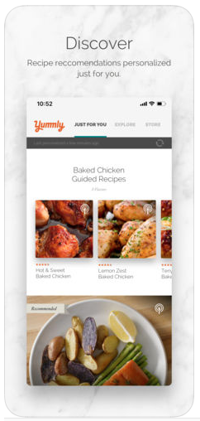
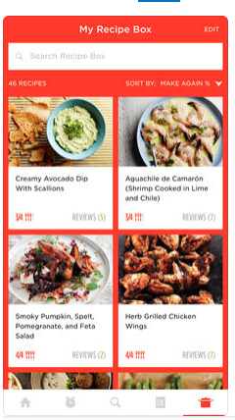
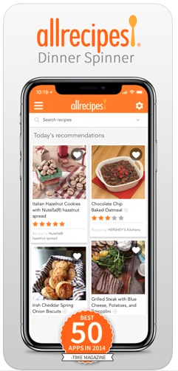

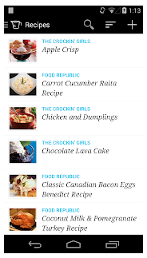
Other Options in Recipe-Searching?
Leftover Produce
Too many:
Options
Functionalities

Slide 4


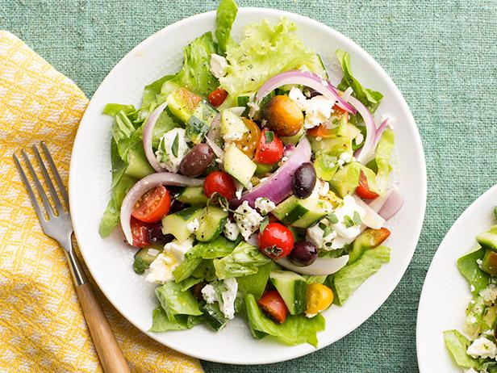
Let’s Build One from Scratch!
Personalized Criteria:
Dish-types
Keto-friendly
image recognition
Leftover Produce
Greek Salad

Slide 5
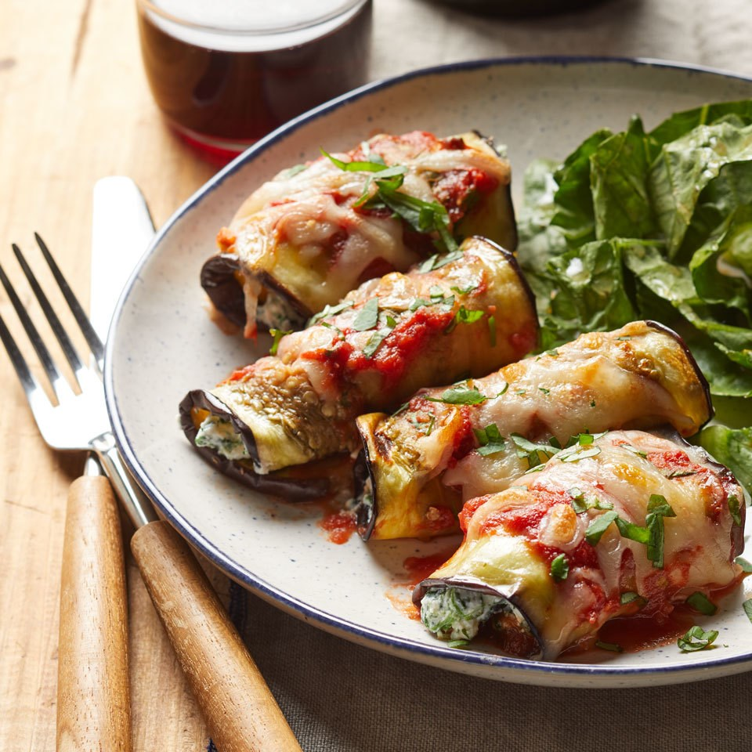


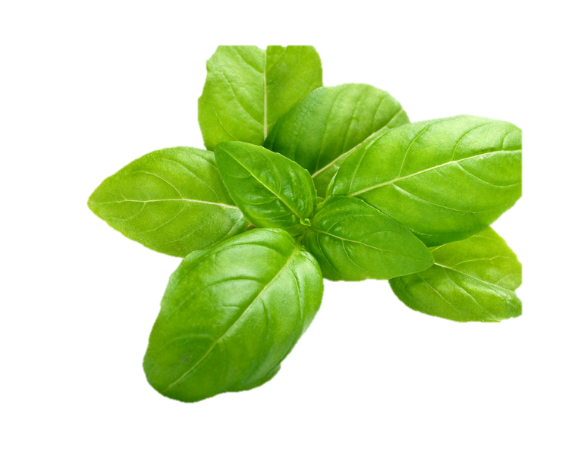
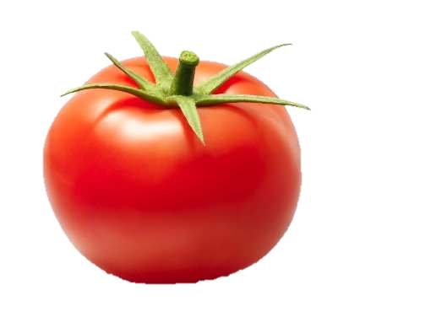
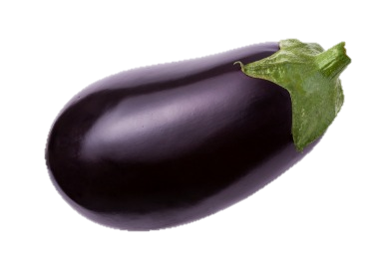
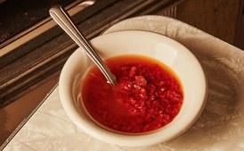




Project Design & Workflow
Data Acquisition
web-scraping
Instructions
Ingredients
Nutrients
Images
Text
Preprocessing,
Engineering
Modeling
Main Dish
Image Classification
(CNN)
NLP
Topic Modeling
(NMF)
Appetizers
Eggplant Rolls
Desserts
Condiments
etc.
Salads
Joining
Text
Tagged-
Documents
Web
Application
BeautifulSoup
Eggplant Picante Sauce

Slide 6
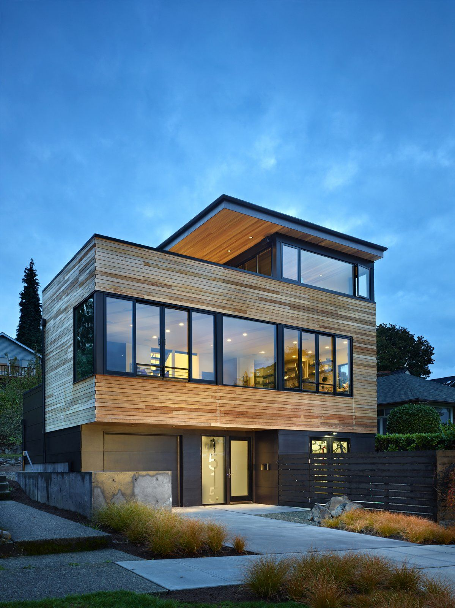

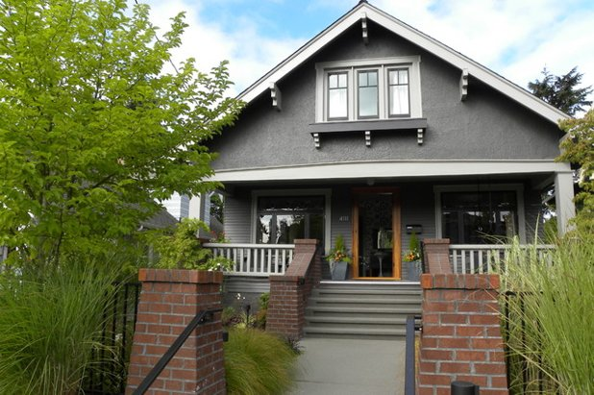


Other Applications
Data Acquisition
Other
Databases
Images
Text
Preprocessing,
Engineering
Modeling
Victorian
Image Classification
(CNN)
NLP
Topic Modeling
(NMF)
Craftsman
Modern-Style Home
Modern
Colonial
Country
Joining
Text
Tagged-
Documents
Web
Application
BeautifulSoup
Craftman-Style Home

Slide 7


Result & Future Work
Classify 10 classes with ~ 95% accuracy
NLP for recipe categorization
Dish-type (5 categories).
Overlapping ingredients
3-ingred.
2-ingred.
1-ingred.
1-ingred.
1-ingred.
Topic modeling improvement
“Real-time” video detection
Dessert?
Larger database
coming soon!!!
Picante Sauce

